Slide 1
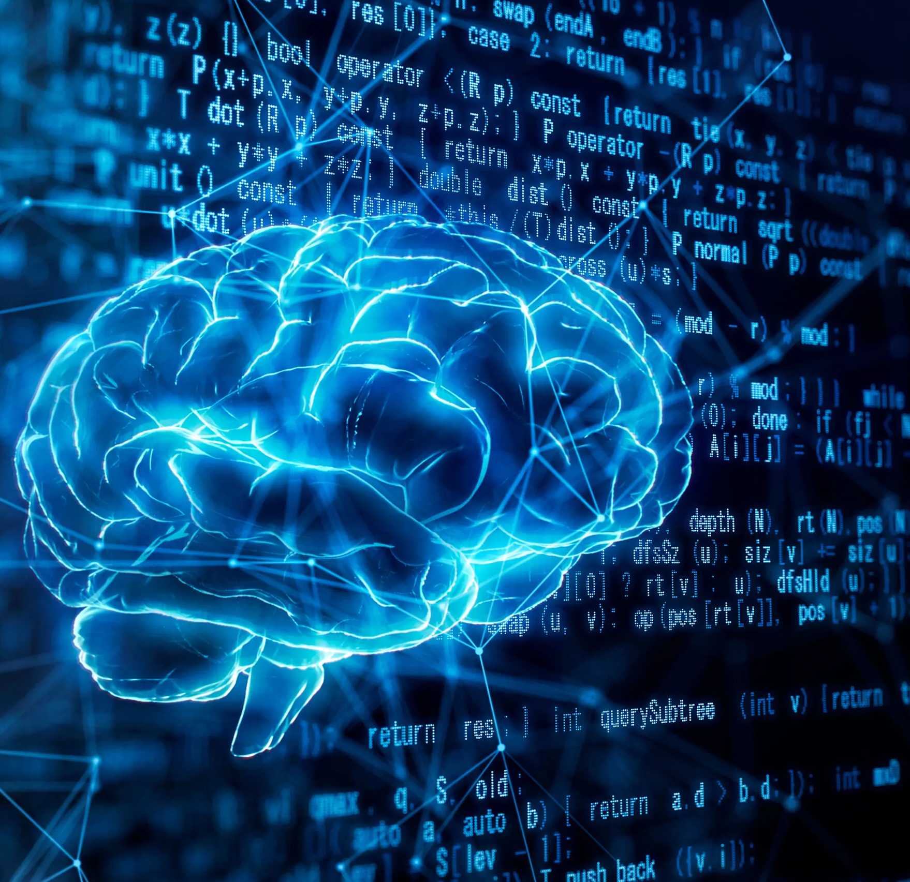
Using Artificial Intelligence to Diagnose Brain Tumors: A Neural Network Approach
-By Bimal Itani
Mentor: Dr Shrikant Pawar
Claflin University
Department of Computer Science| School of Natural Sciences and Mathematics

Slide 2
Agenda:
Introduction
Methods
Results
Discussion
Conclusion
Acknowledgements
References

Slide 3
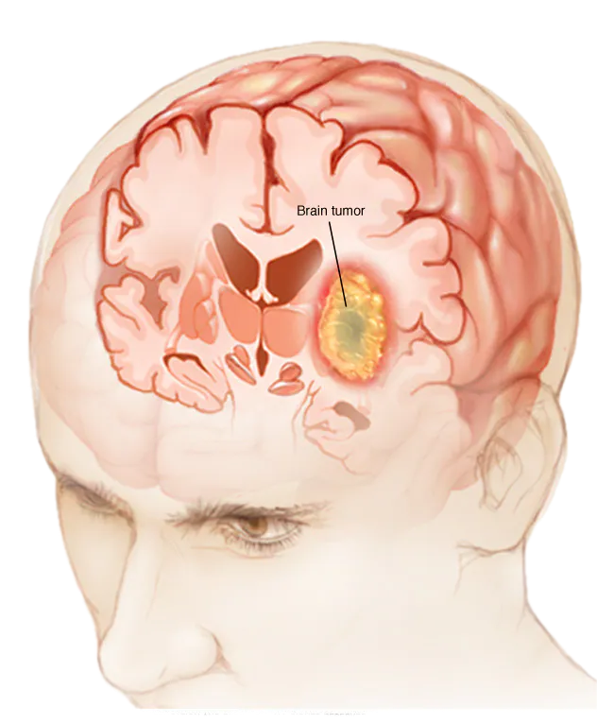
Introduction:
Brain Tumors:
A brain tumor is a growth of cells in or near the brain, encompassing brain tissue, nerves, pituitary gland, pineal gland, and brain-covering membranes.
Brain tumors can be primary (originating in the brain) or secondary (metastatic, spreading from other body parts), varying from benign (noncancerous) to malignant (cancerous).
Symptoms depend on tumor location and size, including headaches, seizures, cognitive or personality changes, and motor dysfunction.
Detection relies on advanced tools like MRI, CT scans, and occasionally biopsy due to the complexity and variability of brain tumors.
The lifetime risk of developing a malignant brain tumor is less than 1%, with an estimated 25,400 new cases expected in the US in 2023, emphasizing the need for ongoing research and innovation in detection and treatment. -American Health Association(AHA)

Slide 4
Surgery:
Surgical removal of the tumor, often the first line of treatment, alleviates symptoms and reduces tumor size, making other treatments like radiation or chemotherapy more effective.
Treatment Modalities of Brain Tumor
Radiation Therapy:
Uses high-energy beams to target and destroy cancer cells, effectively controlling tumor growth and reducing symptoms, particularly for tumors that cannot be surgically removed.
Chemotherapy:
Administers drugs to kill cancer cells or stop their growth, useful for shrinking tumors before surgery or controlling growth post-surgery, often used in combination with other treatments.

Slide 5
Challenges of the current treatments
Diagnosing brain tumors can be delayed, as symptoms like severe headaches and neurological deficits may initially be attributed to other conditions. Diagnosis typically involves imaging studies such as CT scans or MRIs, which can take time to schedule and interpret accurately. This delay in diagnosis can postpone the initiation of appropriate treatment, potentially impacting patient outcomes. Therefore, improving diagnostic efficiency and awareness among healthcare providers is crucial for timely intervention and management of brain tumors.

Slide 6
Project Overview:
Our research focuses on developing an advanced AI model designed to automate the detection and classification of brain tumors from MRI scans of the human brain. Utilizing a Convolutional Neural Network (CNN) architecture, our model is trained on a comprehensive dataset of annotated medical images. By incorporating data augmentation techniques, we enhance the diversity and volume of training data, enabling the model to learn robustly from varied imaging scenarios. This state-of-the-art deep learning approach leverages unique imaging characteristics of brain tumors, aiming for high accuracy and reliability. Our goal is to significantly expedite the diagnostic process, providing faster and more precise diagnoses for brain tumor patients.

Slide 7
CNN(Convolutional Neural Network):
Convolutional Neural Networks (CNNs) specialize in image recognition and computer vision tasks within deep learning.
They excel at extracting features and identifying patterns crucial for tasks like facial recognition and medical image analysis.
CNNs apply convolutional and pooling layers to progressively extract and combine features from images.
Beyond image recognition, CNNs find applications in diverse fields such as speech recognition, natural language processing, and time series forecasting due to their ability to learn intricate patterns.

Slide 8
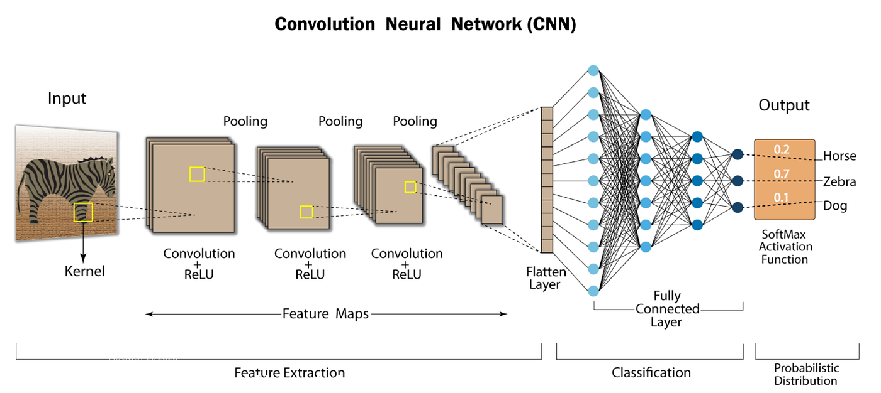
Pic: CNN Architecture
Adopted from: https://nafizshahriar.medium.com/

Slide 9
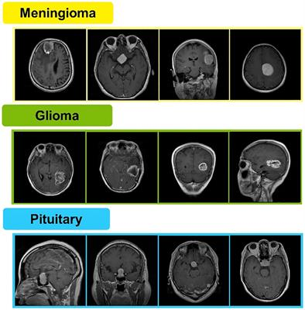
Types of Tumor

Slide 10
CNN Architecture:
VGG-16:
It is a convolutional neural network (CNN) known for its simplicity and depth. Instead of using large filters, VGG-16 relies on small 3x3 filters in its 13 convolutional layers, enhancing feature extraction while maintaining manageability. Each convolutional layer is followed by max-pooling layers to reduce spatial dimensions, culminating in 3 fully connected layers for classification. This straightforward architecture allows for effective image recognition, making VGG-16 both robust and easy to understand, despite its relatively high computational demands.
DenseNet:
It is a special kind of CNN where information flows freely. Instead of just connecting to the previous layer, each layer it gets a boost of information from all layers that came before it in a specific group (called a dense block). This allows features to be reused and helps avoid vanishing gradients, a problem that can hinder deep learning. Overall, it's like giving each layer in the group a cheat sheet of what all the earlier layers learned, making it efficient and accurate.
Xception:
It is a convolutional neural network (CNN) architecture that improves upon the Inception model by using depthwise separable convolutions. Instead of standard convolutions, Xception separates the process into two steps: depthwise convolution, which filters each input channel independently, followed by pointwise convolution, which combines the results. This design allows for more efficient feature extraction and reduced computational complexity.

Slide 11
CNN Architecture result:
CNN Model | Loss | Training Accuracy | Validation Accuracy
VGG-16 | 0.58 | 1 | 0.90
DenseNet | 1.55 | 0.60 | 0.50
Xception | 1.44 | 0.77 | 0.62

Slide 12
Data Augmentation:
Data augmentation in machine learning and deep learning enhances training data diversity without acquiring new data.
Techniques include rotations, flips, shifts, zooms, and color adjustments applied to existing datasets.
Modified versions of original data improve model robustness and generalization to new data.
Artificially expanding the training set mitigates overfitting and enhances model performance overall.

Slide 13
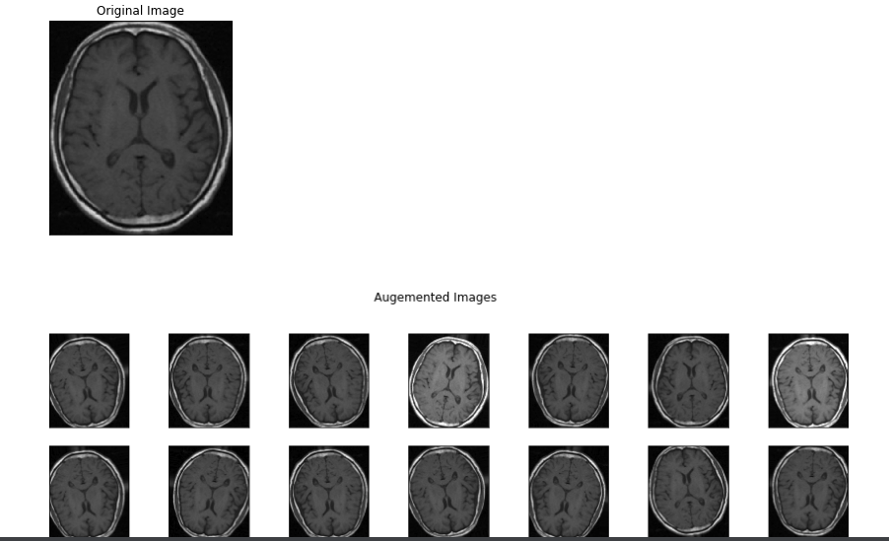
Pic: Data Augmentation

Slide 14
Optimizers:
Optimizers in machine learning minimize prediction errors by adjusting model parameters iteratively during training.
They balance convergence speed and accuracy by updating parameters using gradients from the loss function.
Common optimizers include stochastic gradient descent (SGD) with fixed learning rates, and adaptive methods like Adam and RMSprop.
Each optimizer type offers specific benefits in terms of convergence efficiency and stability tailored to different datasets and model complexities

Slide 15
Optimizers Table:
Optimizer | Validation Accuracy | Test Accuracy | Losses
SDG | 0.82 | 0.7 | 4.4
RMSprop | 0.86 | 0.9 | 1.42
Adam | 0.78 | 0.7 | 2.87
AdamW | 0.9 | 1 | 0.58
Adadelta | 0.42 | 0.4 | 3.5
Adamax | 0.78 | 0.7 | 1.51
Adafactor | 0.54 | 0.6 | 4.28
Nadam | 0.88 | 0.8 | 1.25
Ftrl | 0.82 | 0.6 | 2.88
Lion | 0.86 | 0.8 | 2.65
Loss Scale Optimizer | 0.82 | 1 | 2.47

Slide 16
Optimizer Graph:
The best optimizer for my training was AdamW

Slide 17
Findings of the Research:
Our research on automating brain tumor detection using a Convolutional Neural Network (CNN) architecture with VGG-16 pretrained weights yielded promising results. The model, optimized using the AdamW optimizer, demonstrated a high validation accuracy of 90% and an impressive test accuracy of 100%. While a perfect test accuracy initially appears ideal, it raises concerns about potential overfitting, suggesting that the model might be performing exceptionally well on the test data it has seen but might need further validation on more diverse and unseen datasets to confirm its generalizability and robustness. Notably, although we experimented with various other architectures, the VGG-16 architecture consistently provided the best validation and test accuracies. Further investigation and adjustments are required to ensure the model's applicability in real-world clinical settings.

Slide 18
Research Future Scope:
The scope of this research extends beyond the immediate goal of developing an advanced AI model for brain tumor detection and classification. In the future, this model has the potential to be integrated into clinical workflows, assisting radiologists in making quicker and more accurate diagnoses. Furthermore, the methodology and technology developed can be adapted for detecting other types of cancers and medical conditions using various imaging modalities. As the model continues to learn from a growing dataset of annotated images, its accuracy and reliability will improve, paving the way for its use in personalized medicine. This research also opens avenues for collaboration with healthcare providers to develop comprehensive AI-driven diagnostic tools and enhance telemedicine capabilities, ultimately contributing to more efficient and accessible healthcare services worldwide.

Slide 19
Conclusion:
During this summer research internship, I developed a brain tumor detection model based on the VGG-16 architecture, emphasizing improvements in accuracy, loss reduction, and computational efficiency.
Developed an AI model using the VGG-16 architecture for brain tumor detection, achieving a validation accuracy of 0.90 and a test accuracy of 1.0 with the AdamW optimizer.
Used various architectures including VGG-16, Xception, and ResNet, while exploring different optimizers to optimize performance and accuracy.

Slide 20
Acknowledgements:
This project was generously supported by Claflin University, and I am deeply grateful to the Department of Computer Science for their collaboration and support. My sincere thanks go to my mentor, Dr. Shrikant Pawar, for his expert guidance and insights throughout the research process. I also extend my thanks to Miss Shuler for her support and assistance throughout the program. Also, I like thanks to my fellow research interns, Amrinder Singh and lan Adams, for their assistance and valuable suggestions. Additionally, I appreciate all individuals who contributed to this research with their expertise and support.

Slide 21
References:
ZainEldin, Hanaa et al. “Brain Tumor Detection and Classification Using Deep Learning and Sine-Cosine Fitness Grey Wolf Optimization.” Bioengineering (Basel, Switzerland) vol. 10,1 18. 22 Dec. 2022, doi:10.3390/bioengineering10010018
https://www.kaggle.com/code/ruslankl/brain-tumor-detection-v1-0-cnn-vgg-16
https://nafizshahriar.medium.com/what-is-convolutional-neural-network-cnn-deep-learning-b3921bdd82d5
https://github.com/bimalitani100/Summer-Research-2024
https://www.tensorflow.org/tutorials/images/cnn
https://github.com/tensorflow/tensorflow/blob/master/tensorflow/python/keras/models.py
https://keras.io/api/optimizers/
https://www.analyticsvidhya.com/blog/2021/10/a-comprehensive-guide-on-deep-learning-optimizers/

Slide 22


